Slide 1

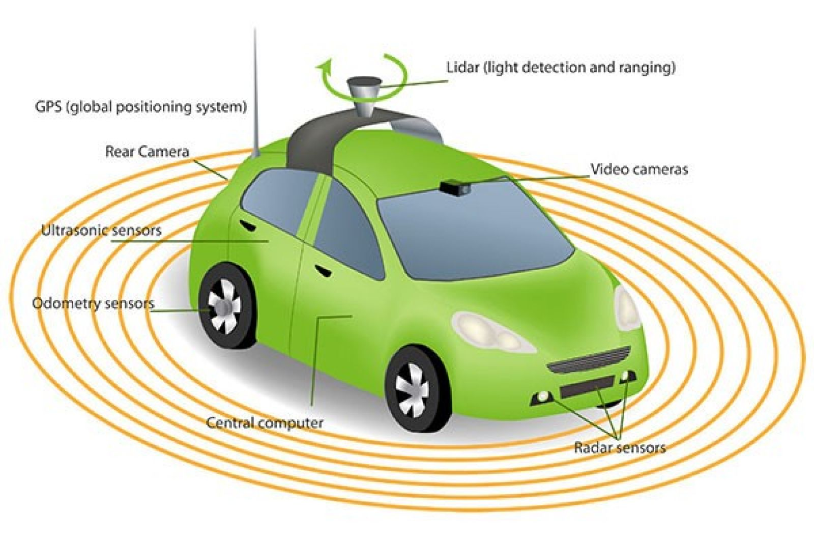
Planning for autonomous cars that leverage effects on human actions
Manish shambu

Slide 2

Abstract
Traditionally, autonomous cars make predictions about other drivers’ future trajectories, and plan to stay out of their way.
This tends to result in defensive and opaque behaviors.
Leverage responses to plan more efficient and communicative behavior.
Approximate human as optimal planer and build a reward function through inverse reinforcement learning.
Robot is indeed capable of eliciting desired changes in human state by planning using this dynamical system.
Notes:
When needing to merge into an- other lane, they will patiently wait for another driver to pass first.
When stopped at an intersection and waiting for the driver on the right to go, they will sit there unable to wave them by.

Slide 3
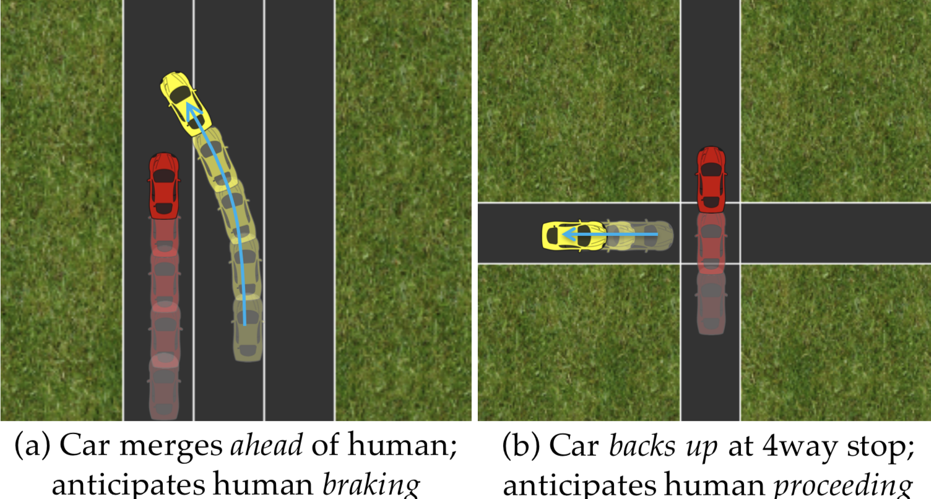
High level overview
An Autonomous car’s action will actually have effects on what other drivers will do.
Leveraging these effects during planning will generate behaviors for autonomous cars that are more efficient and communicative.

Slide 4
Contributions
Formalizing interaction with drivers as a dynamical system.
The human and the robot trajectories are jointly planned as the optimum of some reward function in order for everyone to reach their goals and avoid each other.
Here, the human and robot have their own reward functions, optimizing their own rewards.
Having different reward functions gives the robot the ability to be more aggressive to pursue its functional goals.
Deriving an approximate optimization solution.
Analyzing planning in the human-autonomous car system.
Enabling cars to be aware of the consequences that their action have on other drivers.

Slide 5
Problem statement
Autonomous car(R) interacting in a human(H) environment.
Autonomous car to plan its actions in a manner that is cognizant of their effects on the human driver actions.
Affect human actions which in turn will affect state.
x′ = fR(x,uR)
x′′ = fH(x′,uH)
xt+1 = fH(fR(xt,utR),utH)
RR(x0, uR, uH) = ∑ rR(xt, utR, utH) - Maximizing the reward function of Robot.
The robot has to find uR at every step that maximizes it’s reward.
u∗R = arg max RR(x0, uR, u∗H(x0, uR))
Notes:
X – state
fR – dynamics model
uR – control the human chooses

Slide 6
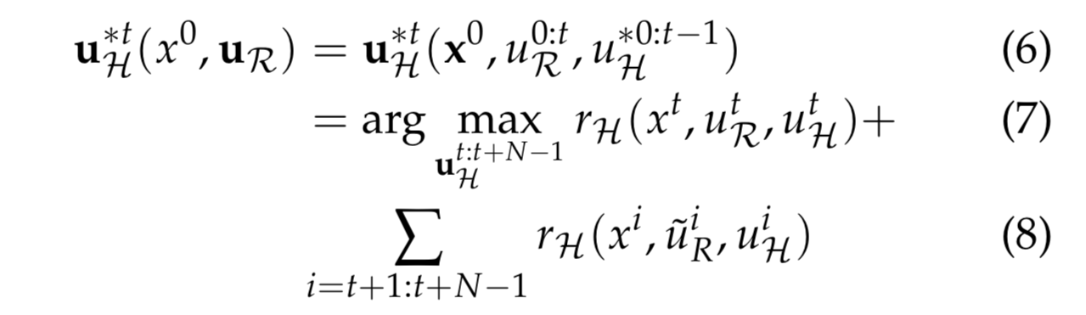
u*H approximation assumption
Robot should have access to the human’s brain, able to simulate what the human would do in various scenarios.
Typicaly u∗H(x0, uR) = u∗H(x0) .
Assume that velocity of human driver does not change.
They take take the human prediction of what the robot does into consideration
Notes:
Prediction on robot actions.
Robot maintaining a constant velocity or some complex assumption.

Slide 7
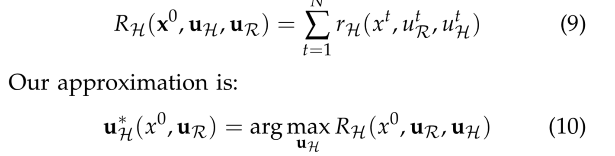
Simplifying assumption
Assumption that human has access only to first few time steps of the Robot’s actions.

Slide 8
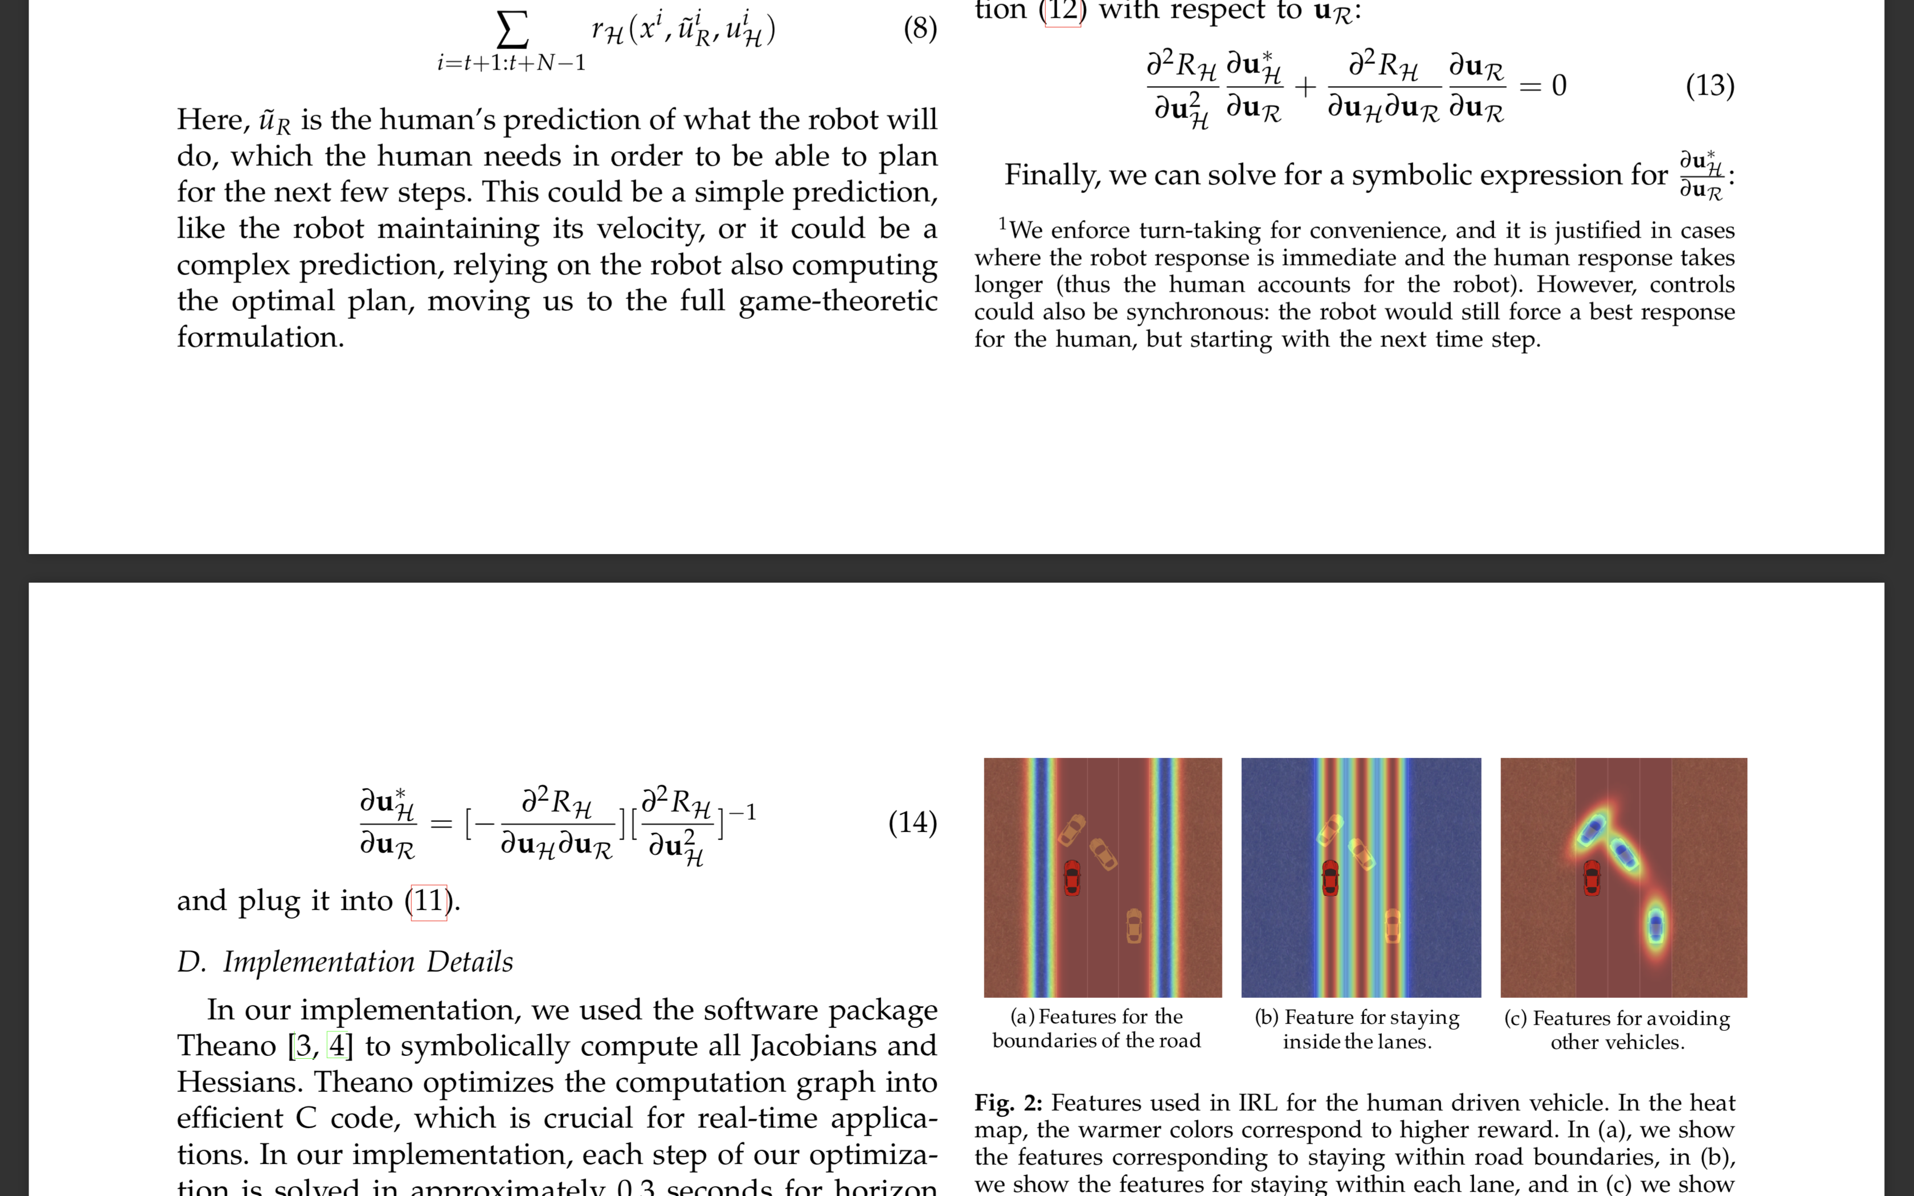
Solution
rH obtained through inverse reinforcement learning
Solving optimization using L-BFGS.
Notes:
Quasi newton method that approximates inverse hessian implicity.

Slide 9
Implementation Details
Theono software to compute Jacobian and Hessians.
0.3 seconds for N = 5.
2.3GHz Intel Core i7 + 16GB RAM.

Slide 10
Human Driver Reward
Obtain rH(xt, uR, uH) from human data through inverse reinforcement learning.
01
Parametrize the human reward function as a linear combination of features.
02
Apply Max entropy model- Trajectories having higher reward being more probable.
03

Slide 11
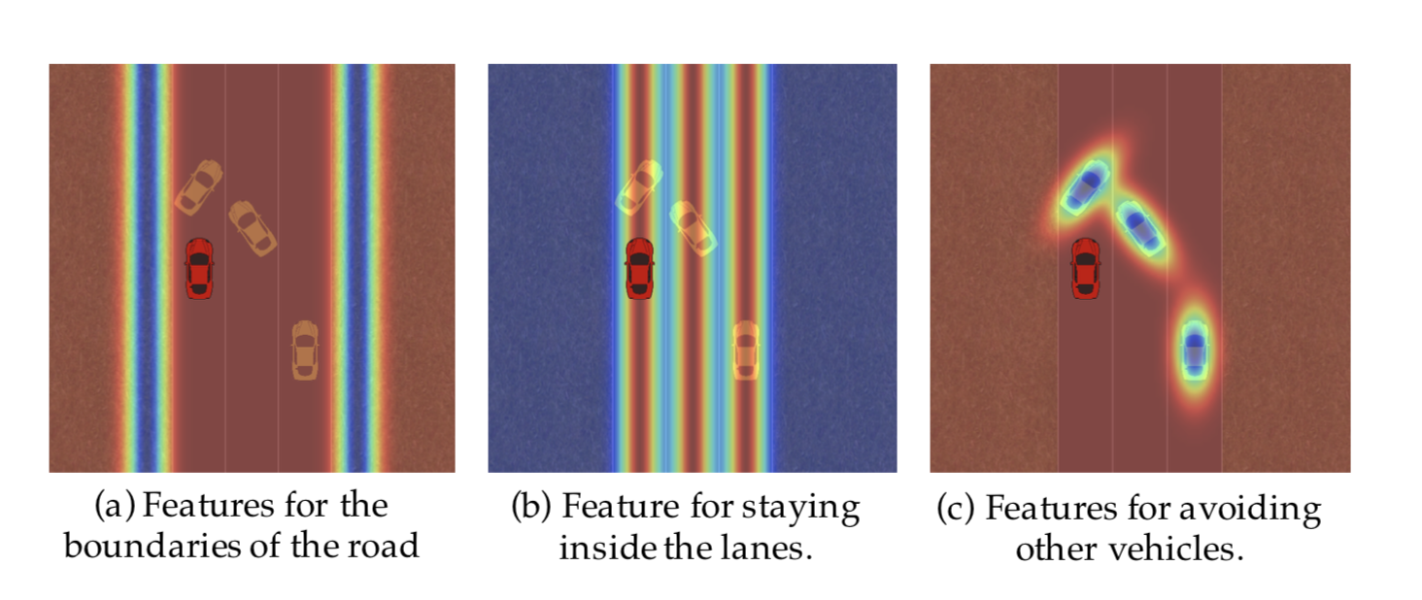
Feature Representation
Notes:
Staying in the border
Staying on the lane
Collision avoidance – non spherical Gaussians.

Slide 12
Conditions for analysis
In the control condition, the car is given the reward function to avoid collisions and have high velocity.
01
In the experimental condition the reward function is augmented with a specific desired human action.
02

Slide 13
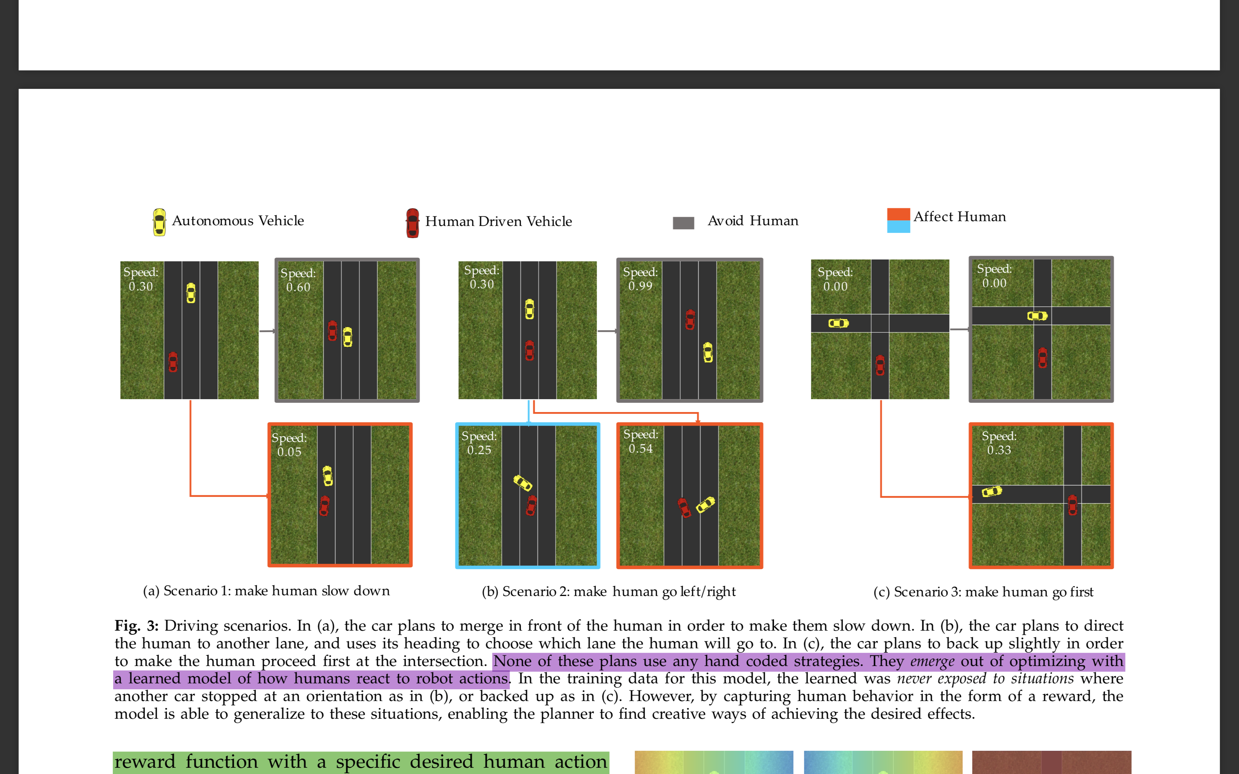
Making Human Slow Down
Control condition - the human moves forward uninterrupted
Experimental condition - the robot plans to move in front of the person, expecting that this will make them slow down.
Notes:
In experimental condition the robot’s reward is augmented with –ve of the square of human velocity, which encourages robot to slow the human down.

Slide 14
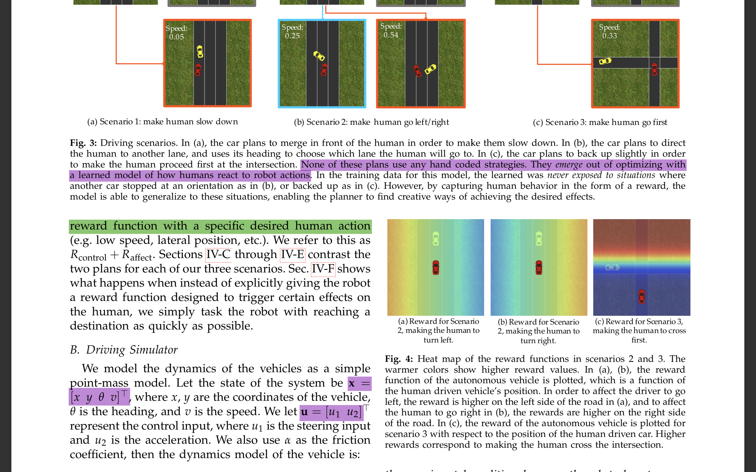
Making human go left/right
Autonomous vehicle plans to change the human’s lateral location or lane.
Control condition - human moves forward, and might decide to change lanes
Experimental condition - robot plans to purposefully occupy two lanes expecting this will make the human move around it by using the unoccupied lane.
Notes:
Experimental Condition – Augment the robot’s reward with the lateral position of the human.

Slide 15
Make Human go first
Autonomous vehicle plans to make the human proceed first at an intersec- tion.
Control condition – Car goes in front of the human.
Experimental Condition – slightly back up purposefully to make human go first.
Notes:
In the experimental condition, we augment the robot’s reward with a feature based
on the y position of the human car y middle of the intersection y0.

Slide 16
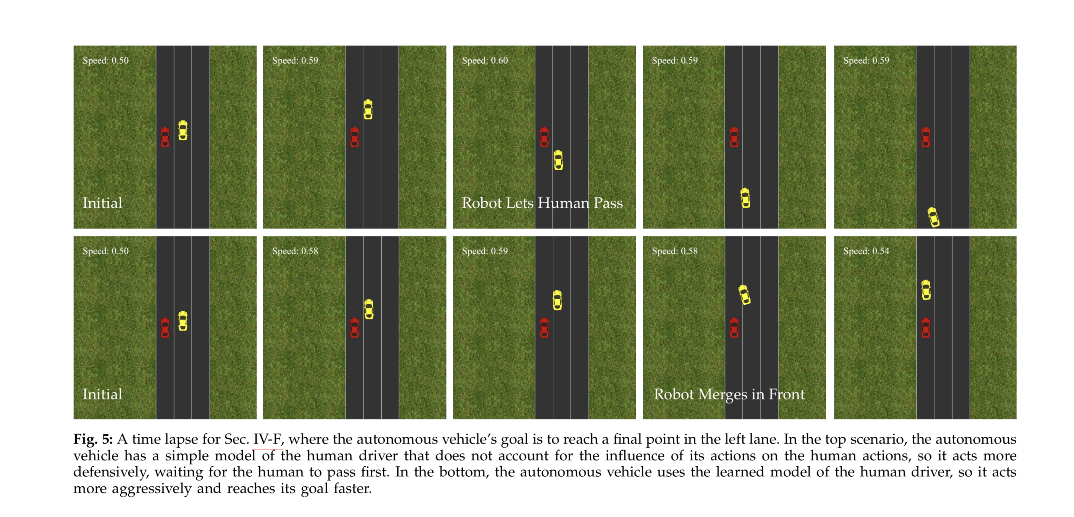
Behaviors emerge from efficiency

Slide 17
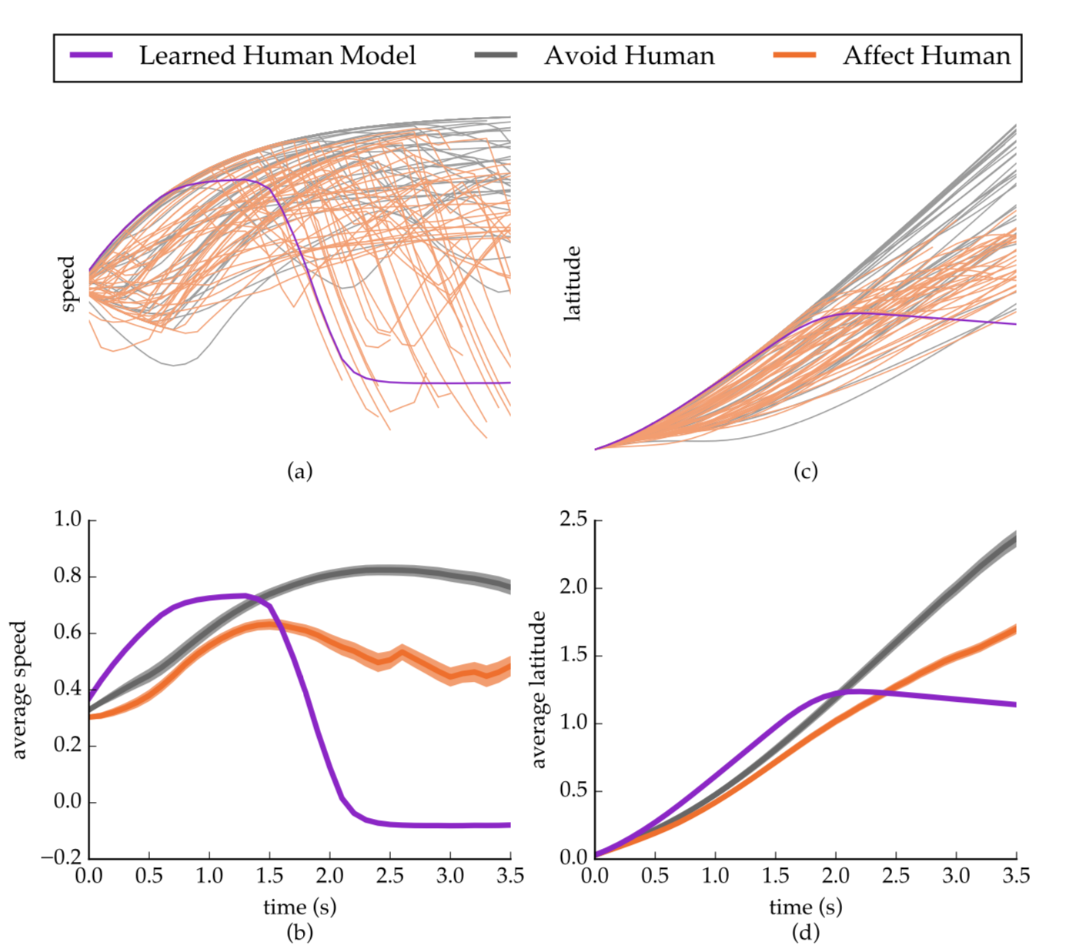
Experiment on real users
Analysis of Variance
Scenario1:
Square speed is lower in experimental than in the control condition. (Human moved slower and the robot was successful in inducing affect on the human.)
Notes:
Control condition – grey
Experimental condition – orange
Simulated user – purple – ideal case for the robot

Slide 18
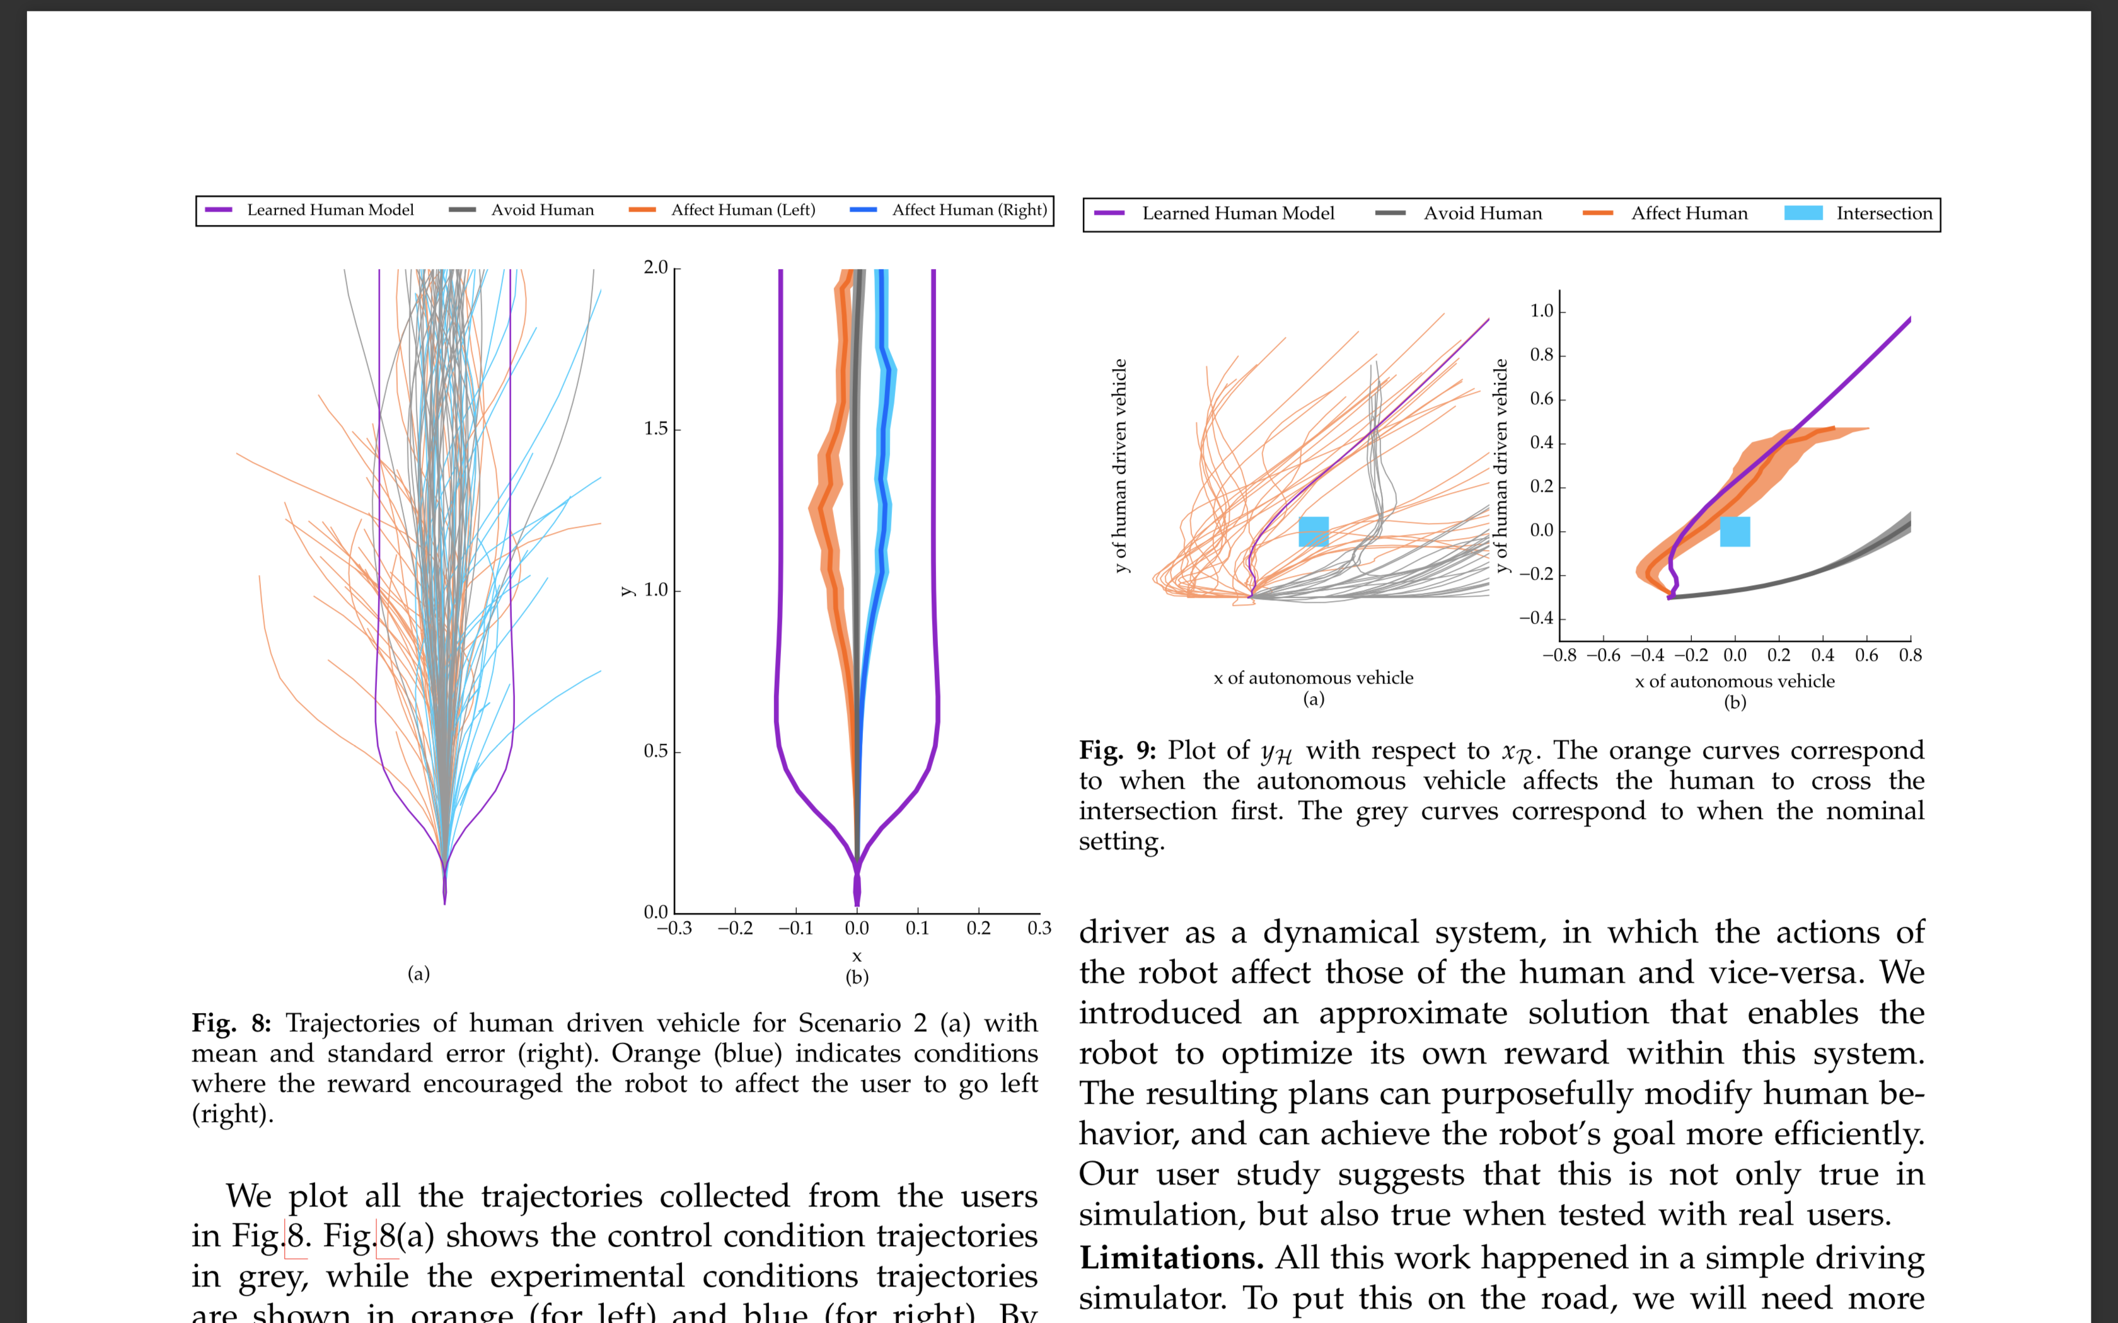
Experiment on real users
Scenario 2:
Car goes more left or right in the experimental than in the control condition.
Notes:
Control condition – grey
Experimental condition – orange
Simulated user – purple – ideal case for the robot

Slide 19
Experiment on real users
Ordinal Logistic regression
Scenario 3:
More users went first in the experimental condition. (Blue box as reference.)
Notes:
The lines corresponding to these trajectories travel above the origin, which is shown with a blue square in this figure .

Slide 20

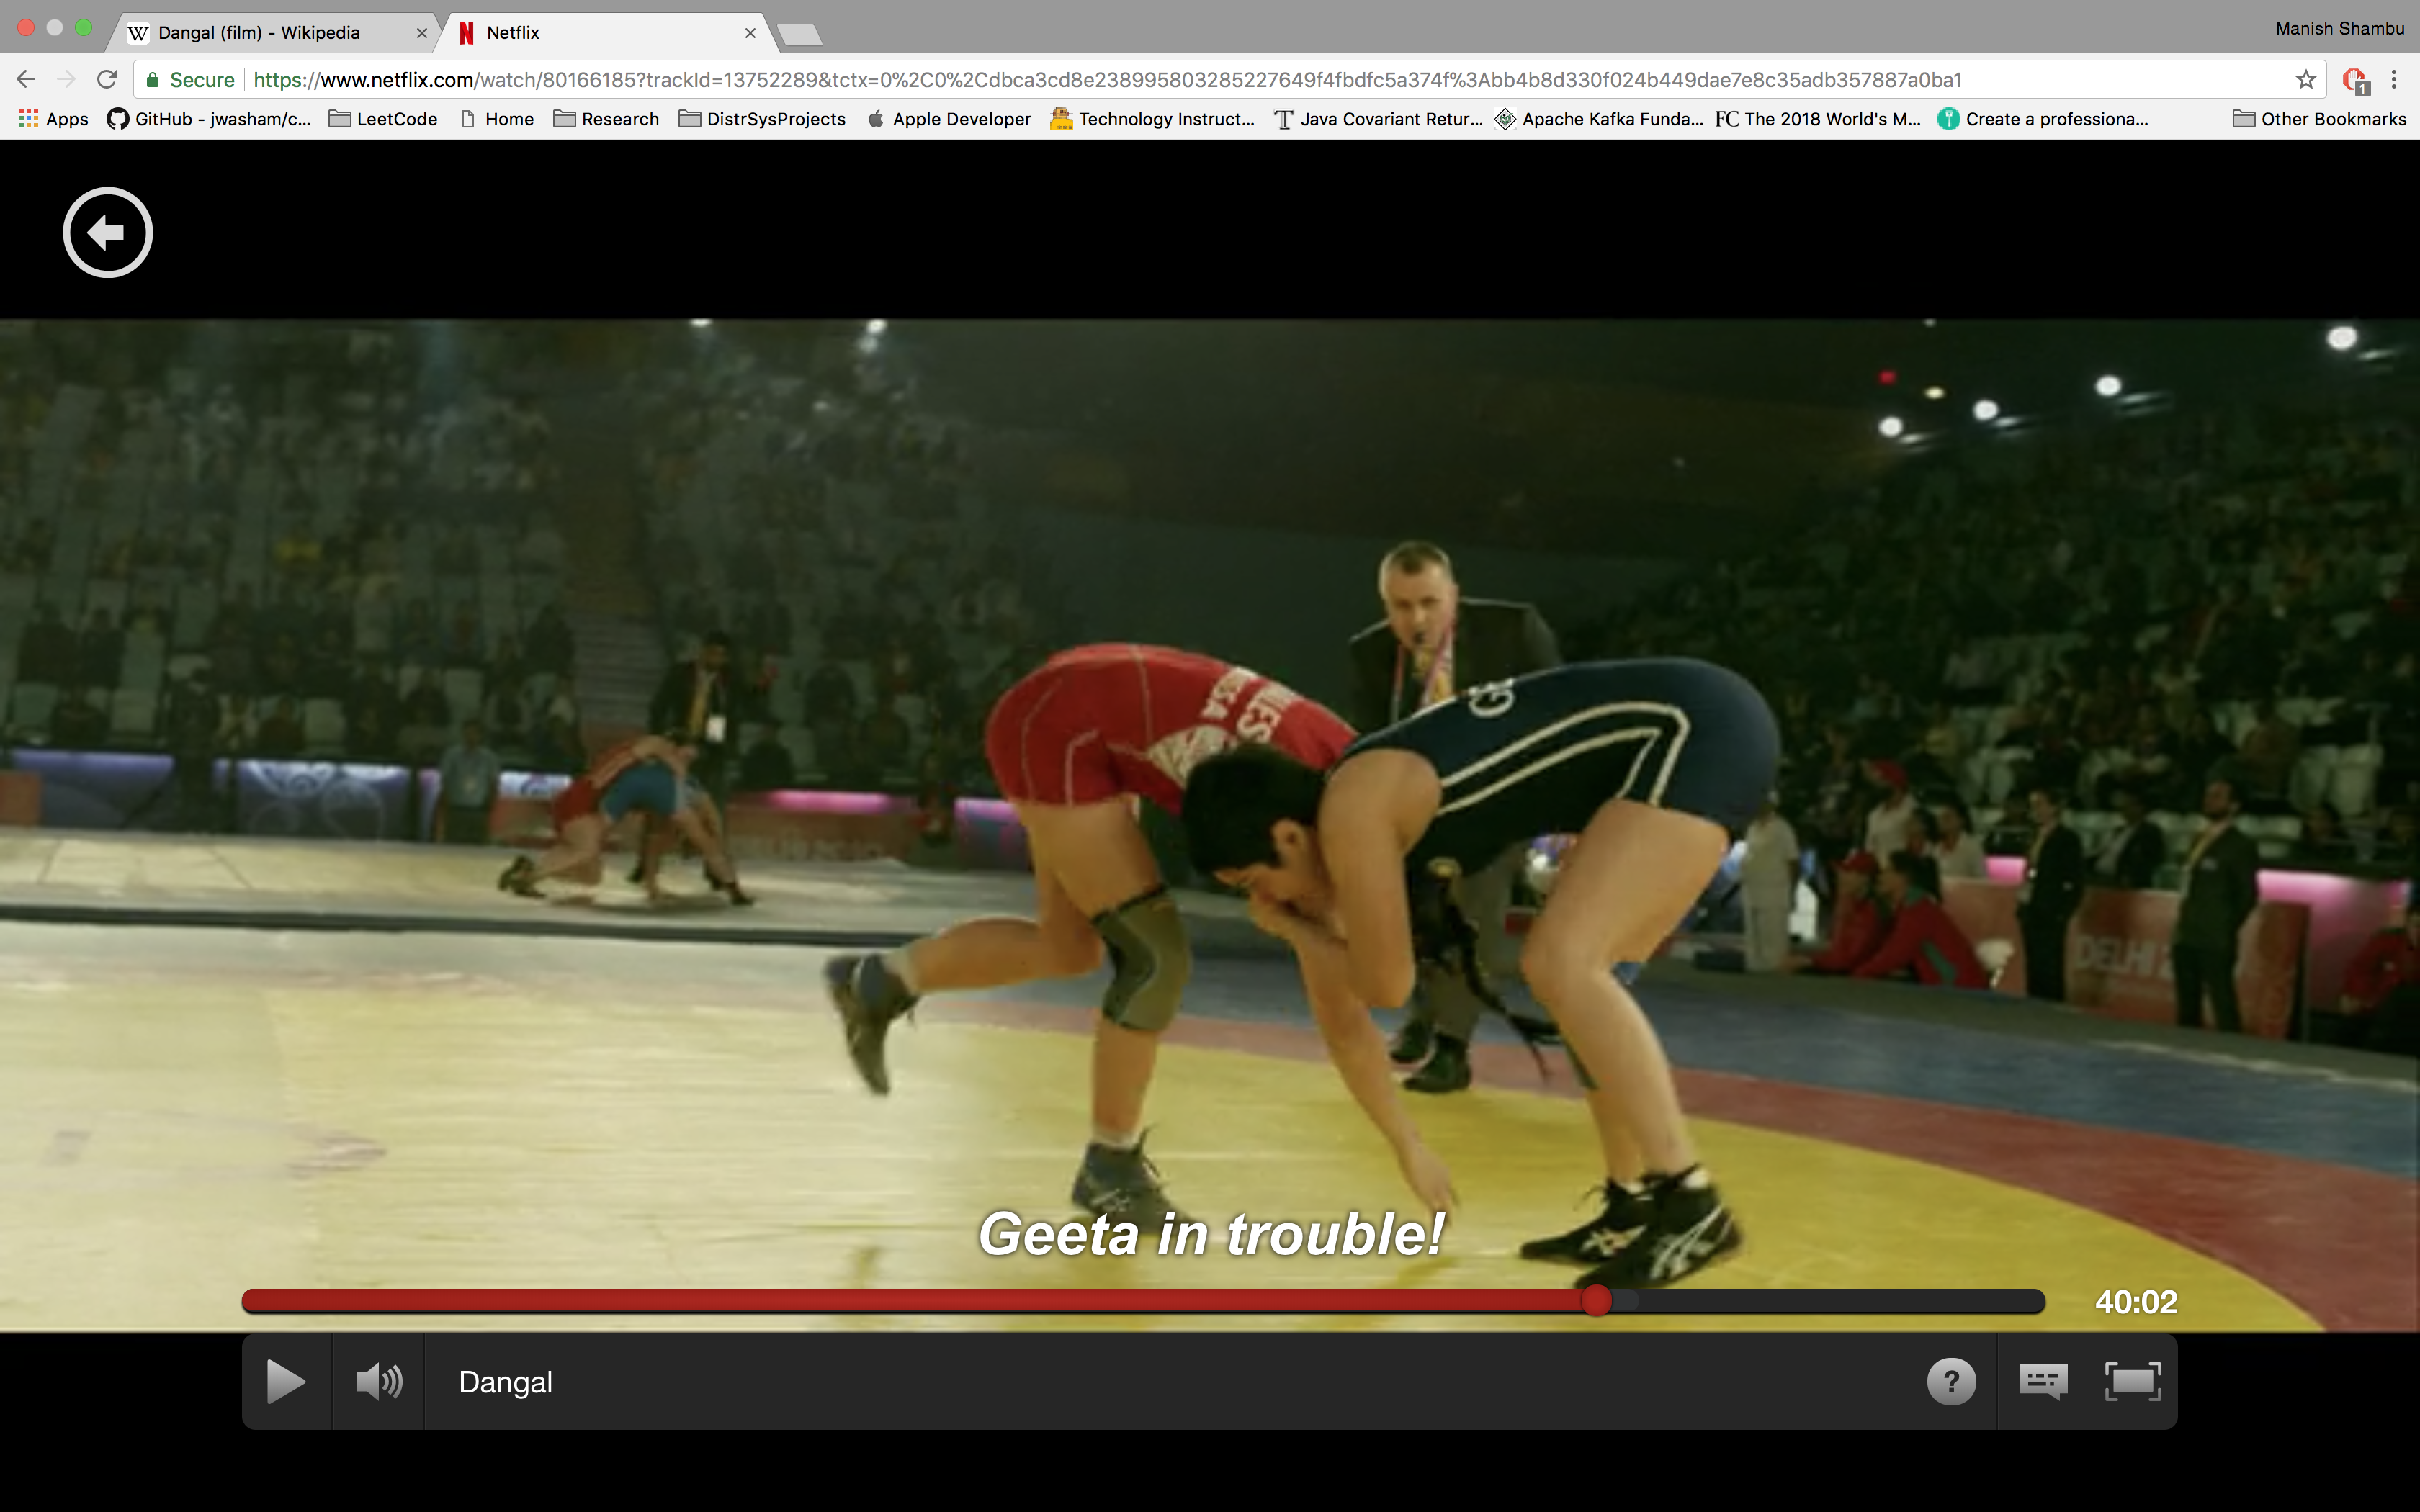
Inspiration from real life
Defending vs aggressive.
Robot should know when to be defensive.

Slide 21
Limitations
Not all drivers act the same and replanning is not the end solution to address this.
Using a probabilistic dynamics model

Slide 22


